Slide 1


Forklift Scheduled Maintenance Analysis
Team 11 - Yash Shah, Yiting Zhong, Zhenjie Shen

Slide 2
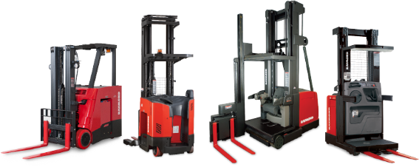
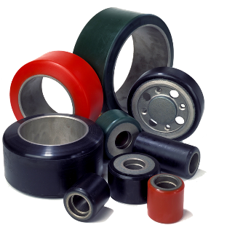


Content
Background
Objective and Data Pre-processing
Scheduled Maintenance Time Period Analysis
Cost Ownership Analysis
Optimal Service Interval Prediction
Conclusion

Slide 3
Part I Background

Slide 4
The Best of Both Worlds - Worldwide.
Raymond offers the reach and resources to be your global material handling partner, optimizing uptime and maximizing productivity by offering:
The flexibility and agility of a small regional player
Personal, local relationships
Fast response times—24 hours a day
More personalized and customized solutions
The strength and stability of the world’s largest forklift manufacturer
National and international capabilities
Industry-leading reliability
Scalable solutions to fit your needs—anywhere, anytime

Slide 5
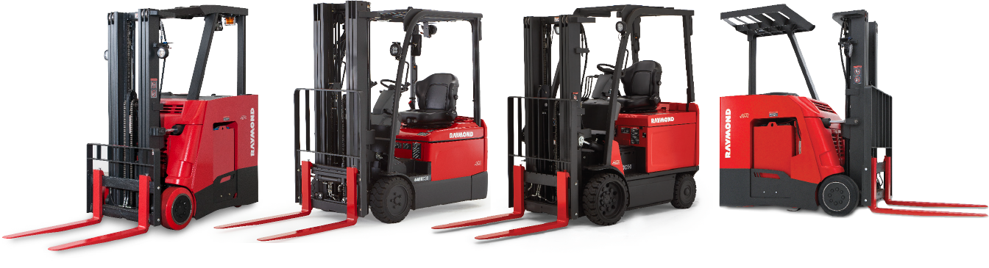

Counterbalanced Lift Trucks
IDEAL APPLICATIONS
Dock operations (trailer loading/unloading)
Transport
Put away
Racking
Durable, powerful, and highly maneuverable, Raymond Counterbalanced Trucks feature a compact footprint and agile steering, making them ideal for confined spaces and close-quarter operations.
• Trailers • Ramps
• Boxcars • Stacking areas

Slide 6
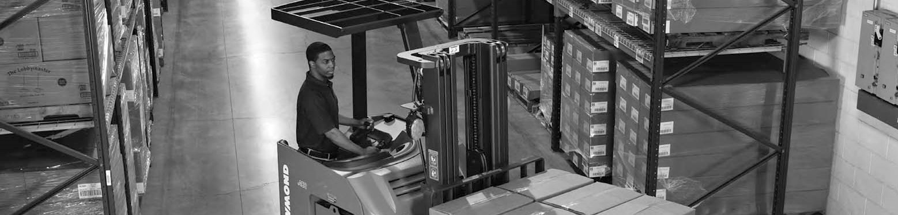
Stand-Up Counterbalanced Trucks: Overview
Multi-purpose vehicles—ideal for frequent operator on/offs—designed to work alone or with other systems as part of a total material handling solution.
Greater maneuverability and precise handling in tight spaces with a compact footprint and agile steering
Superior operator comfort with vibration-reducing Comfort-Stance suspension system (optional on 4150)
Faster, smoother operation, longer battery life, and reduced downtime with exclusive ACR System™

Slide 7
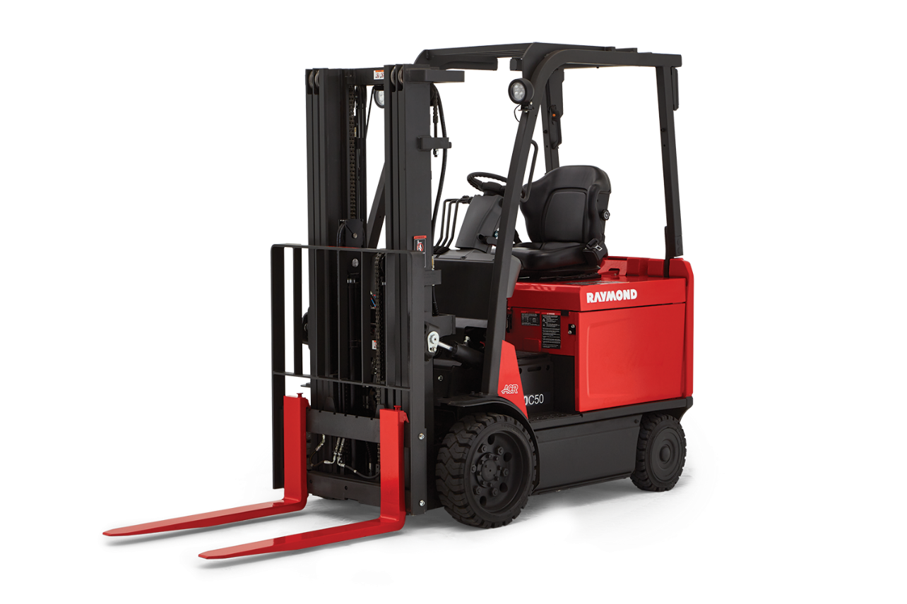

Sit-Down Counterbalanced Trucks: OVERVIEW
Comfortable, durable and maneuverable, ideal for a wide array of tasks around the warehouse, from heavy-duty dock operations to packing and shipping applications.

Slide 8
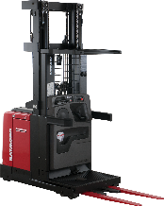

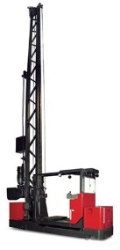
Narrow Aisle and Very Narrow Aisle Solutions
IDEAL APPLICATIONS
Case/Order picking
High-level pallet/load handling
Heavy-duty very narrow aisle applications
Raymond introduced the industry to the narrow aisle concept by pioneering the world’s first narrow aisle forklift and the Reach-Fork® truck. Today we continue to lead the way with a fleet of vehicles designed to help you expand vertically, compress horizontally, and optimize existing storage space.
NARROW AISLE
VERY NARROW AISLE
Orderpickers
24- or 36-volt configurations to suit your operation.
Swing-Reach Trucks Increase pallet capacity by up to 300% within the same warehouse footprint.
Reach-Fork Trucks Allow double-deep pallet configurations for increased storage density and greater space utilization.
Transtacker Trucks Ultimate space utilization for heavy-duty and 24/7/365 very narrow aisle warehouse applications.
Sideloaders Simplify the handling of long and bulky loads in narrow aisles.

Slide 9
Glossary
Variable Definition
SM – Scheduled Maintenance.
Parts – Parts which need to be repaired by Raymond.
Overhead Reach – The strict structure for each truck. 5 main Overhead Reach types – SUCB, SIT-DOWN, STAND-UP, 3-WH and PACER.
Mast Type – The type of upright support for each truck. 5 main Mast types – C30, C40, C50, C60 and Others.
Failure Type – Type of failure. For example – ELE = Electric, MEC = Mechanic, HYD = Hydraulic, MOT = Motor, etc.
SM Interval Groups – The Average days between Scheduled Maintenance services for trucks were classified into Interval Groups. Detailed definition provided in the next section.
Installation Year – Installation Year of truck
Meter Hour – Meter hour for each truck to date from the time of its manufacture date.
Max Meter Hour – Meter hour on the last date of service/max meter hour recorded in a truck’s lifetime.
Cost – Repair Cost of each service for a truck
Cost per hour – Cost per meter hour of a truck.

Slide 10
Part II Objective and Data Pre-processing

Slide 11
Data Pre-processing
Objective
The objective of this project is to identify current scheduled maintenance plan time periods for Raymond Counterbalance models (overall time between services) and analyze the costs associated with the forklifts.
Once baseline time periods are discovered, attribution of trucks to the appropriate Service time interval groups. Finding the total cost ownership for the Counterbalance Trucks, analyze and compare the total costs between interval groups.
Finally building a model to predict the optimal service time period based on the various factors provided.
Data Cleaning
Our Total Dataset consisted of almost 1 million observations (972,144) and 32 factors with multiple entries for each service for all 3 types of trucks (Only Parts Services, Parts & SM Services, Only SM Services)
Missing values for Cost were replaced by median imputation using medians for multivariate factors like median cost for particular parts and Overhead Reach types.
Date and Time were organized in a particular format needed for the analysis.
The Data was then summarized down to 8320 observations (which were 8320 unique trucks) and with factors like cost, number of services, Average SM Interval and some other factors aggregated for all these trucks before conducting our analysis as per the business problem.

Slide 12
Part III Scheduled Maintenance Analysis

Slide 13
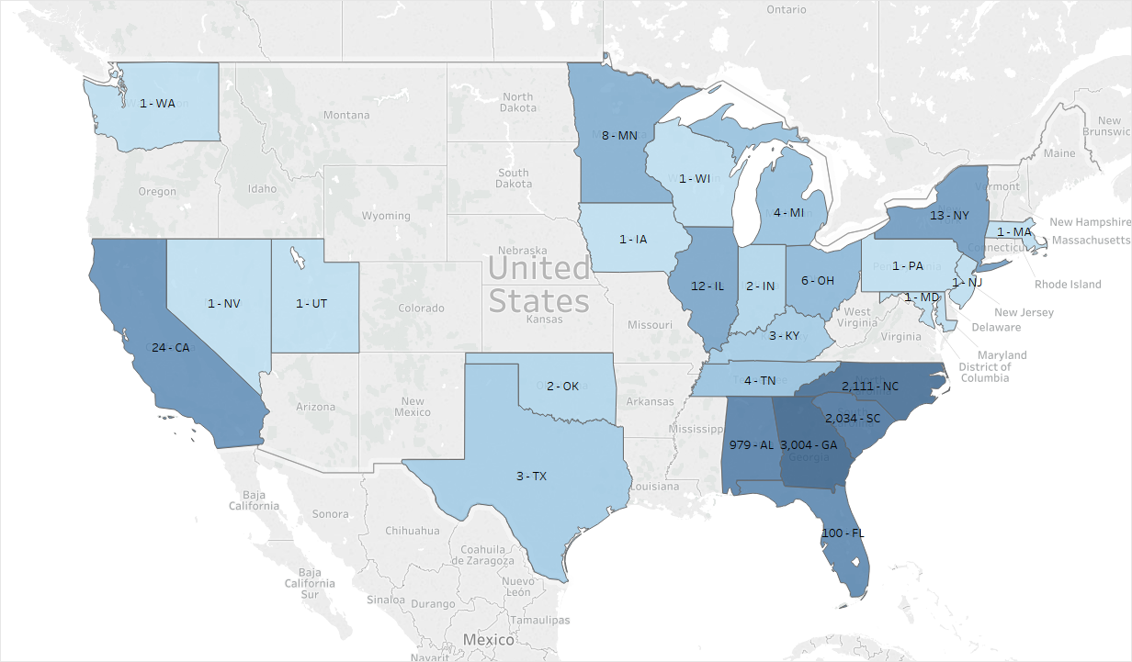
Distribution of Number of Total Repair services by State

Slide 14
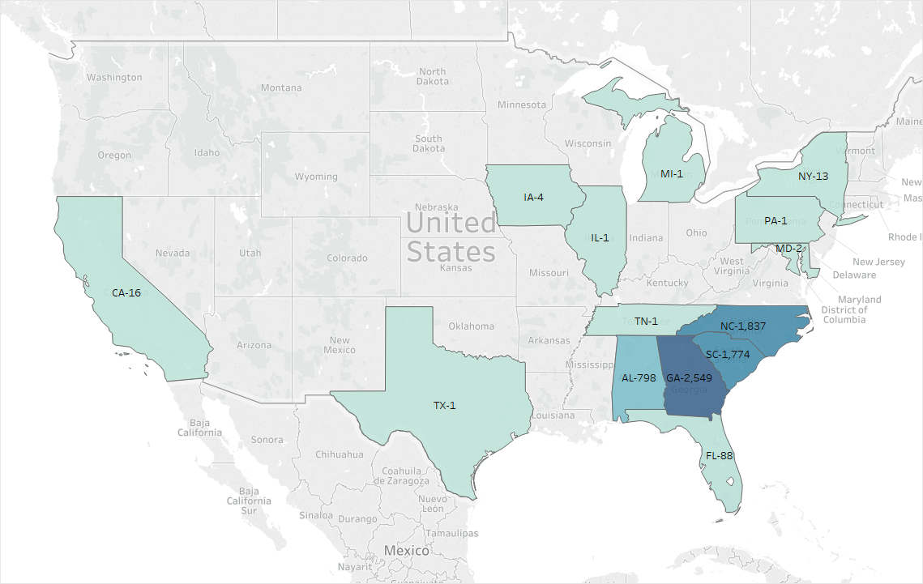
Distribution of Number of Scheduled Maintenance Services by State

Slide 15
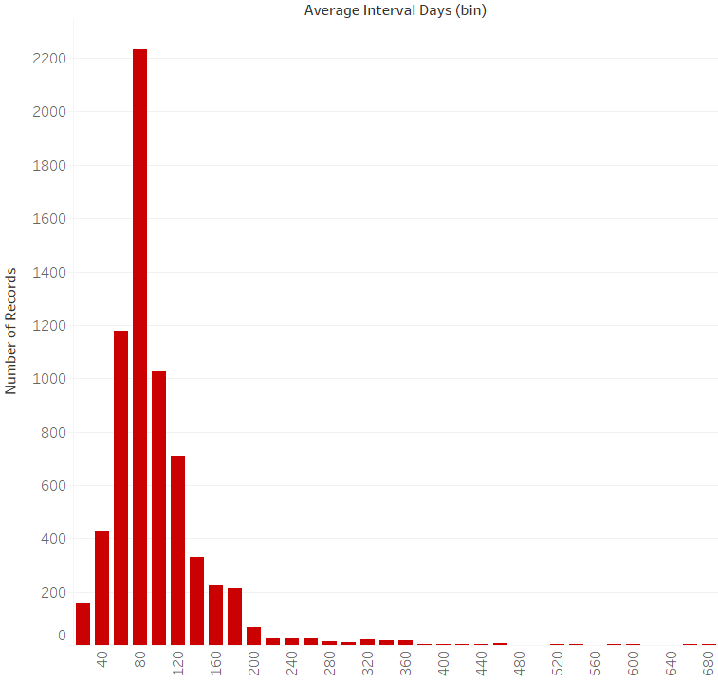
Distribution of Average Interval between Services for these trucks
Summary
Average Intervals for each truck are Average of number of days between all services for that particular truck.
The plot has a very elongated right tail due to the presence of outliers as there is a lot of gap in time between Scheduled Maintenances, i.e. higher average intervals between services for trucks.
One reason is change of customer name when a new date occurs, and another is having less number of services, i.e. the second service after the first repair occurs after a long time interval.
After running a few statistical tests below, it’s confirmed that the best fitting distribution for the Average Interval data (Time in days between services) is Burr distribution.

Slide 16
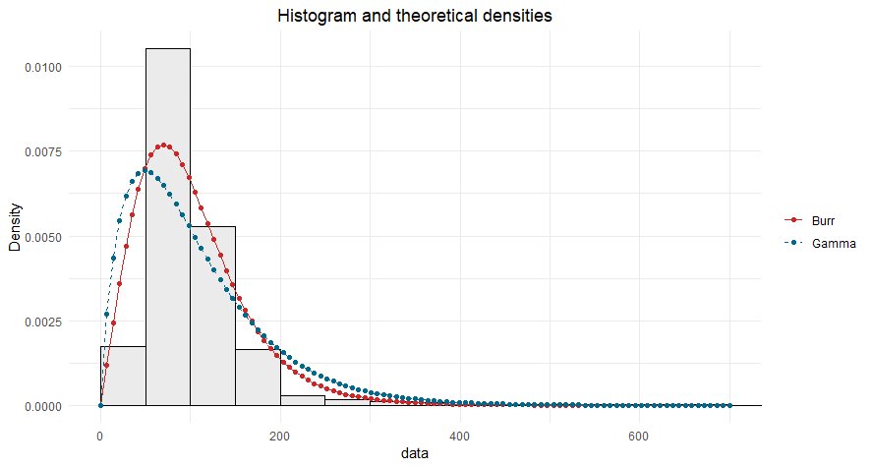
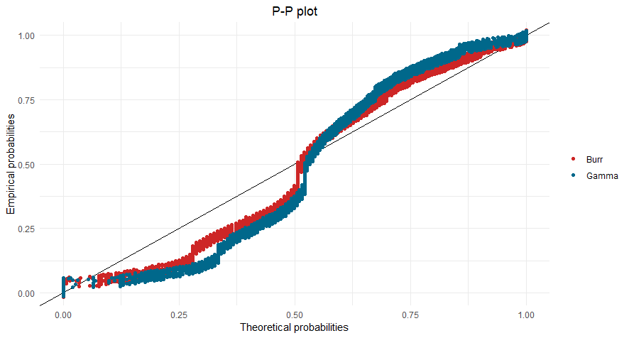
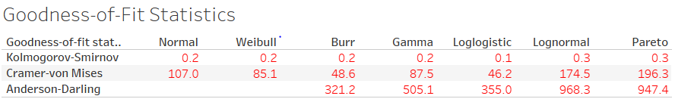
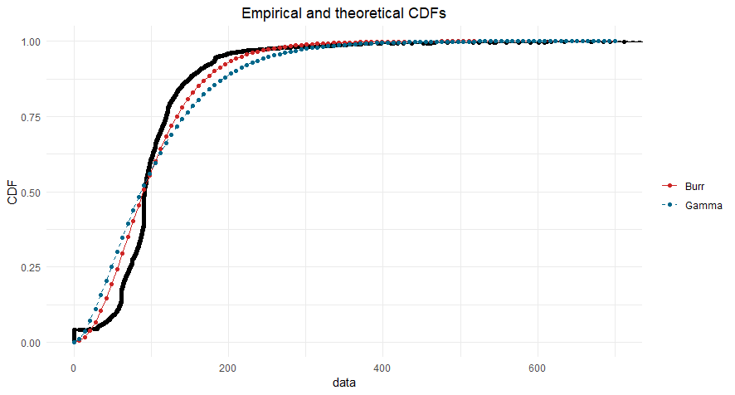
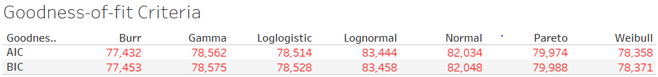
Fitting Distribution to the Average Interval Data

Slide 17
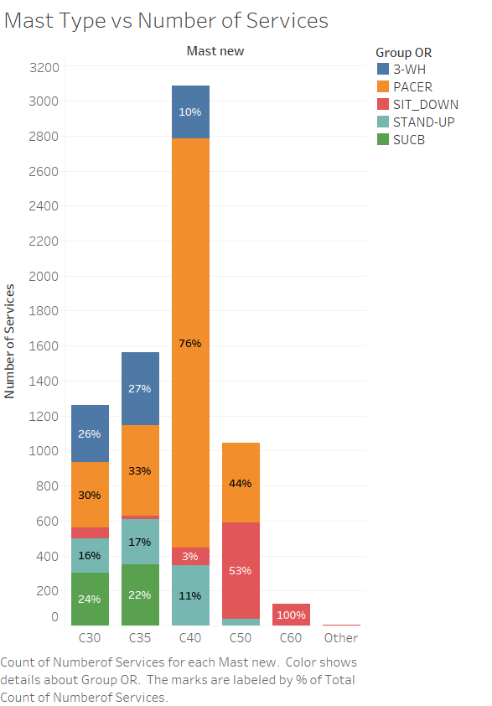
Mast Type of truck versus Number of Services colored by Overhead Reach
Summary
The plot shows the Mast Types distribution against number of services and how they’re distributed within each overhead reach type

Slide 18
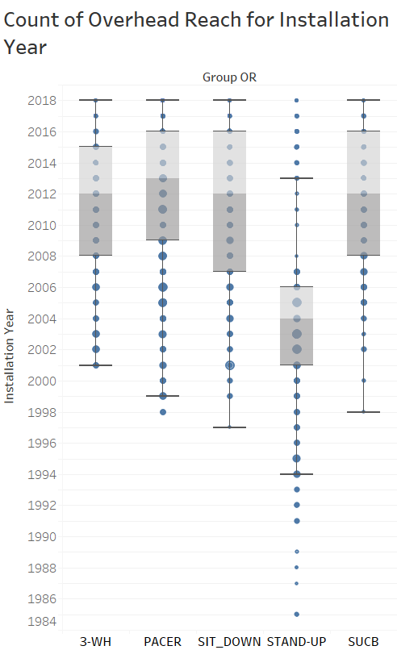
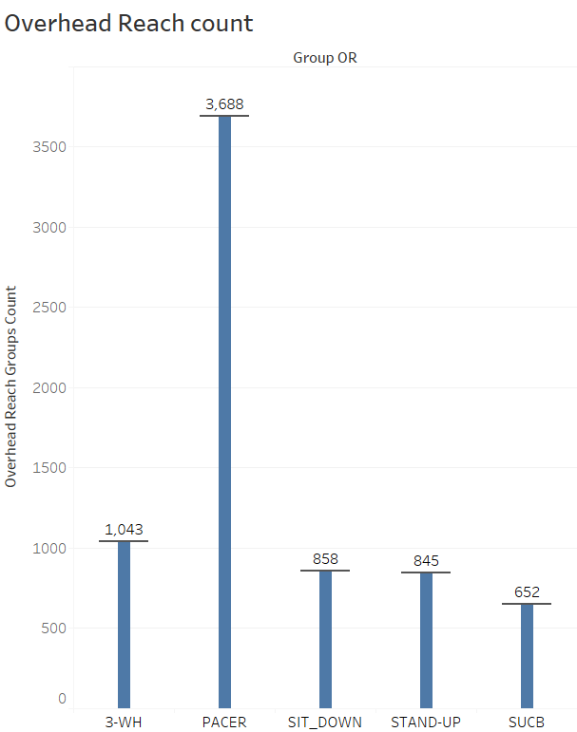
Overhead Reach analysis
Summary
The first plot against time indicates that the Stand-up group truck is the oldest type compared to the others which are relatively new.
The second plot indicates from the Count of Overhead Reach Count plot, Pacer group truck has the most number services.

Slide 19
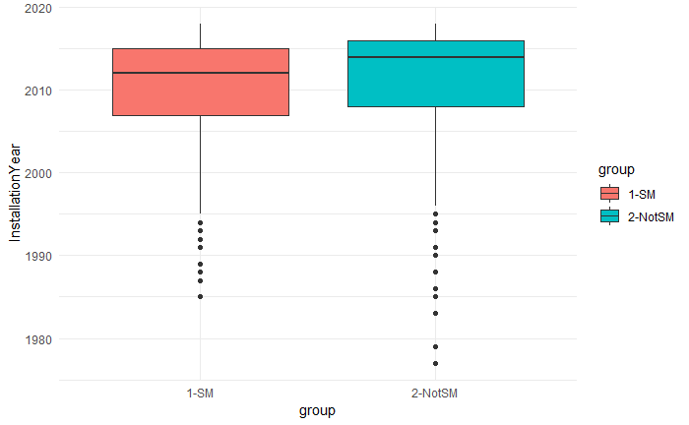
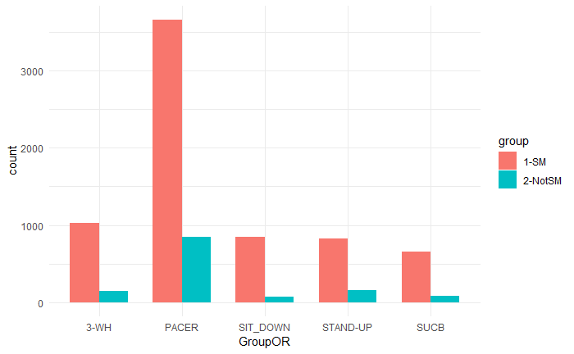
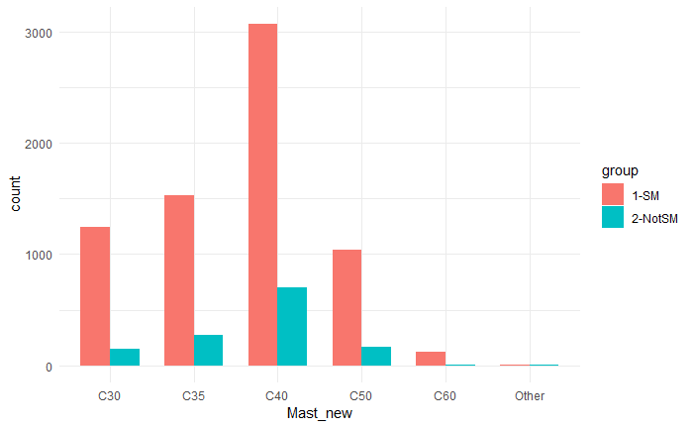
SM Trucks versus Non-SM Trucks
Summary
Non-SM trucks are generally newer than SM trucks
For Overhead Reach, PACER is the most common; 3-WH and STAND-UP have a higher proportion in non-SM trucks
For Mast Type, C40 is most common; C30, C35 and C50 are also very common

Slide 20
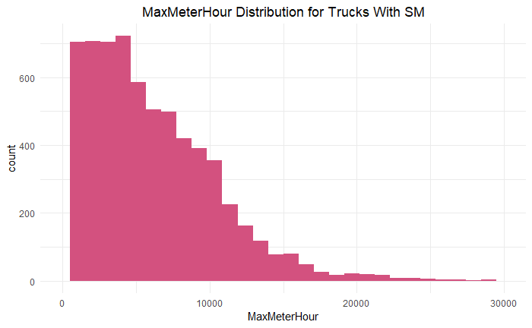
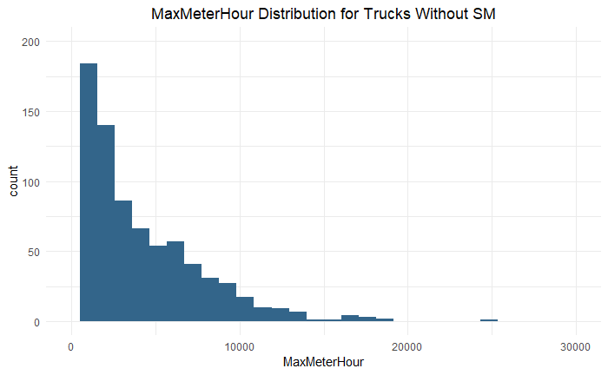
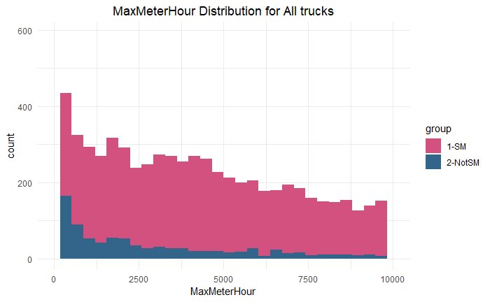
SM Trucks versus Non-SM Trucks
Summary
Maximum Meter Hour for SM trucks are more concentrated in (0, 10000), especially in (0,5000)
Non-SM trucks have generally fewer meter hours, with most of them concentrated in (0,2500)

Slide 21
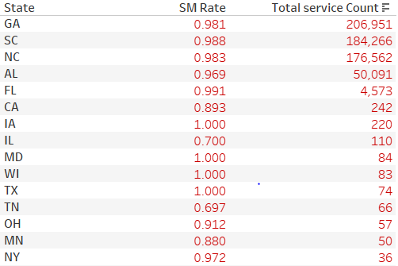
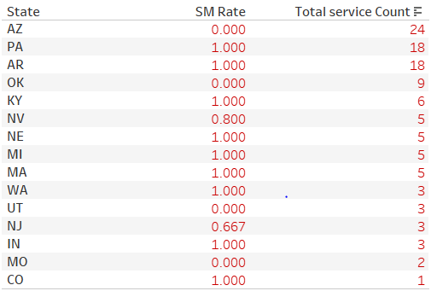
SM Trucks versus Non-SM Trucks
Scheduled Maintenance rate for each state, sorted by descending order of the total service number
Summary
GA, SC, NC are three states with largest service counts with SM rate over 98%. Top 10 states all have relatively high SM rate.
Some small states are not participating in SM plans.

Slide 22
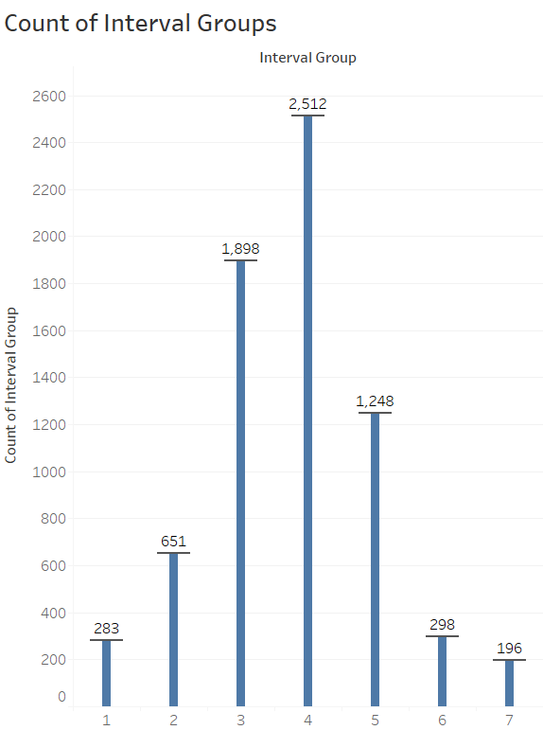
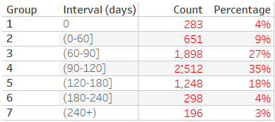
Break Down SM Interval into Groups
Summary
These Interval Groups are assigned to all trucks depending on their Average Interval Days between Scheduled Maintenance Services.
By checking the distribution (quantiles, median) of average SM interval, the Average Interval Days were split into 7 groups with these intervals where Group 1 represents trucks with no SMs as of year to date.
The groups are as below:

Slide 23
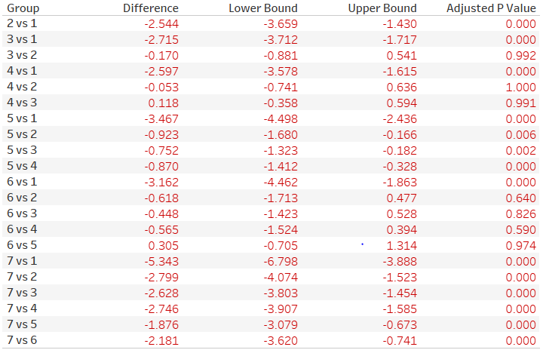
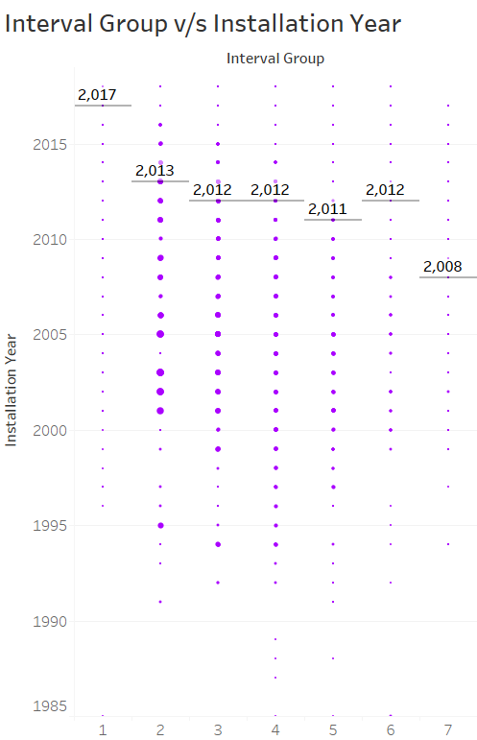
SM Interval Group versus Installation Year – ANOVA Analysis
Summary
There is significant difference between Installation Year for different interval groups.
Pairwise comparisons show that Group 1, 7 and 5 are significantly different from the other groups based on installation year.

Slide 24
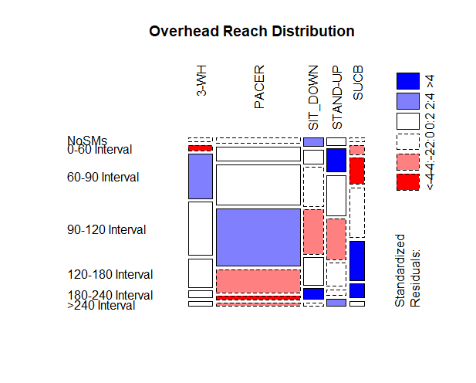
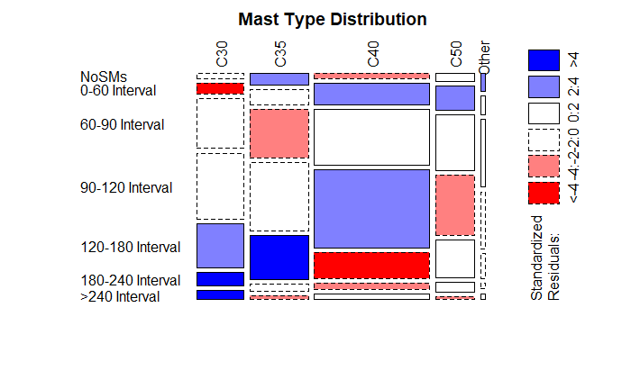
SM Interval Group v/s Truck Model
Summary
Summary
The above plot indicates truck models of STAND-UP and 3-WH are more likely to have frequent schedule maintenance;
Models of SIT-DOWN and SUCB are less likely to have frequent schedule maintenance.
The above plot indicates truck mast types of C40 and C50 are more likely to have frequent SM plans
Mast Type of C30, C35 are less likely to have frequent SM plans.

Slide 25
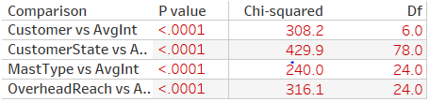
Chi-Squared Tests for Group Comparison
Summary
2*2 Chi-Squared tables for 4 comparisons
Chi-squared tests to check whether significant differences exist between different groups. P values are all very small, indicating the groups are all significantly different.

Slide 26
Part IV Cost Ownership Analysis

Slide 27
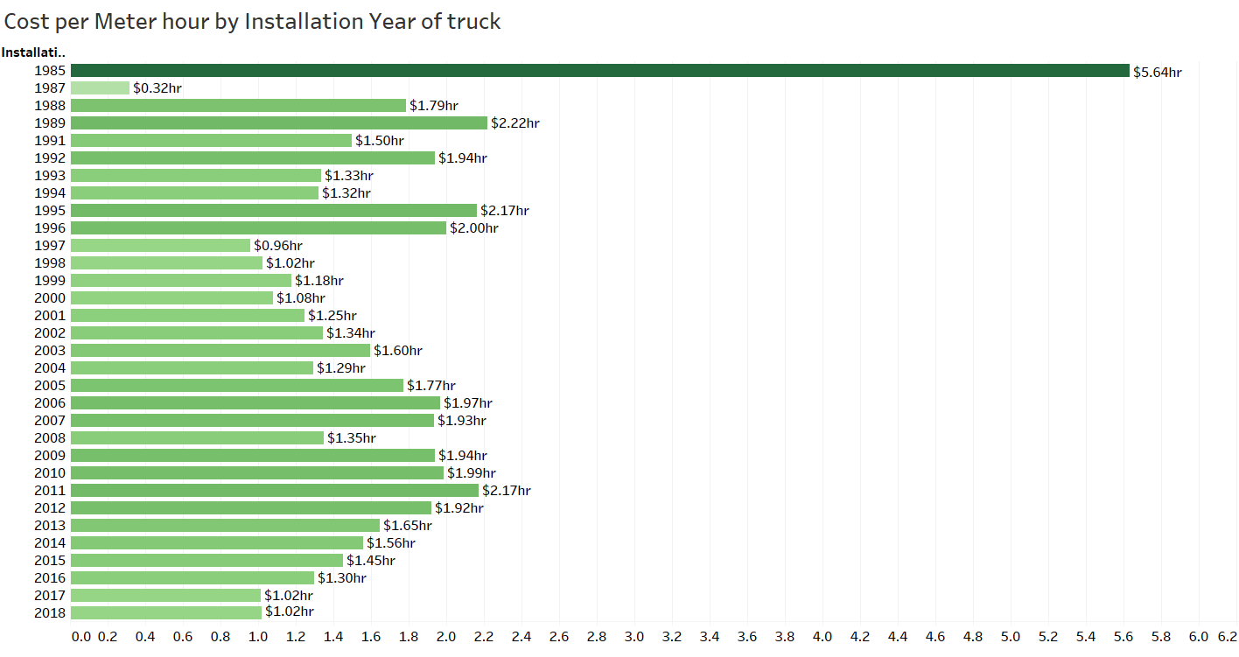
Cost per Hour of trucks
Summary
The highest of median cost per hour for each truck was in 1985 (due to some outlier entries), after which it has significantly decreased over the years.
Note: Median is shown here as the total would vary due to meter hours increasing in continuation each year for the trucks.

Slide 28
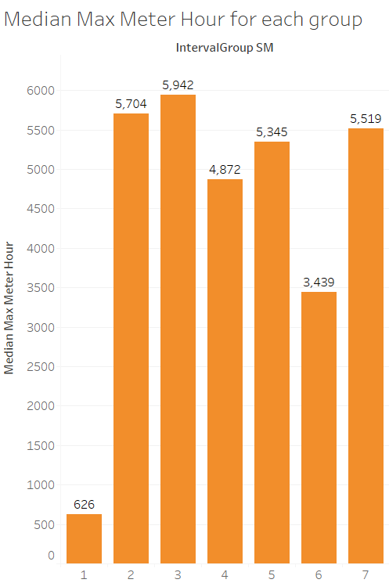
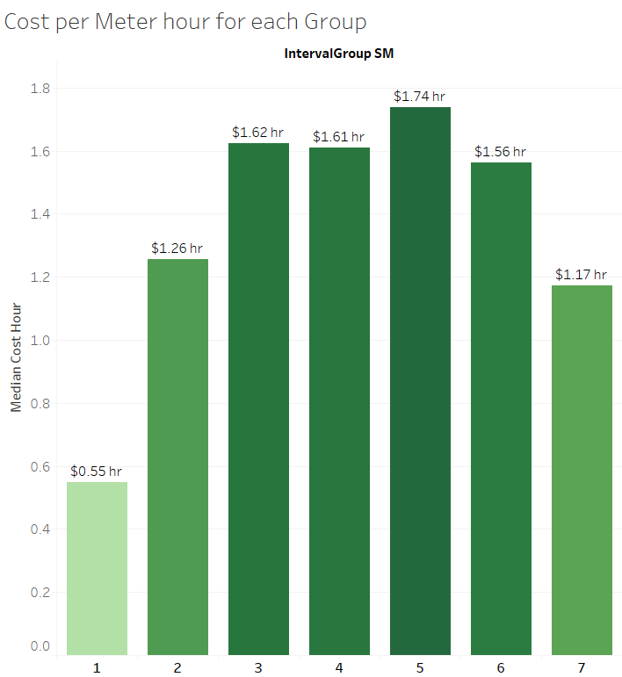
Cost per Meter Hour for Interval Groups
Summary
Interval Group 5 has the highest Median of Cost per Meter Hour for each truck. Interval 3 has the highest Median for Meter Hours for each truck.
Interval Group1 gives the lowest total cost of ownership for the trucks.

Slide 29
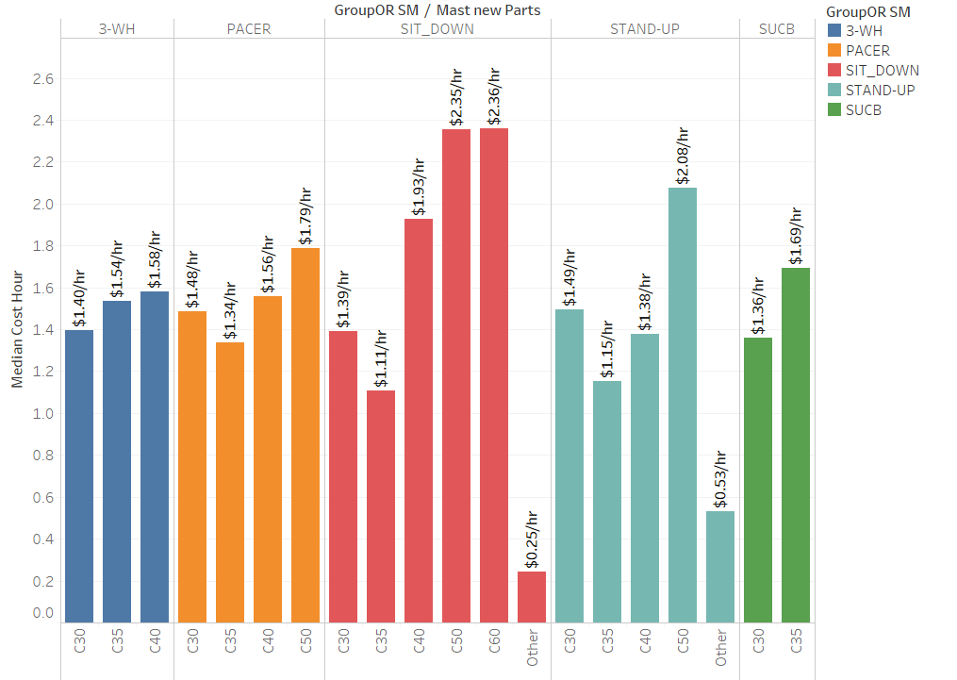
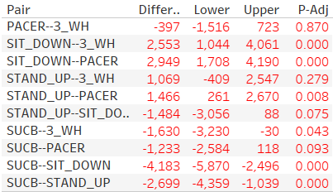
Analysis of Cost (Overhead Reach and Mast Type)
Summary
C50 and C60 within have significantly higher costs per hour than all other types than all other Mast types.
Lowest cost per hour is for Other Mast Types.
C35 within PACER, SIT-DOWN and STAND-UP types have lower costs per hour than other mast types in these respective Overhead Reach categories. (3 highest Overhead Reach Types).

Slide 30
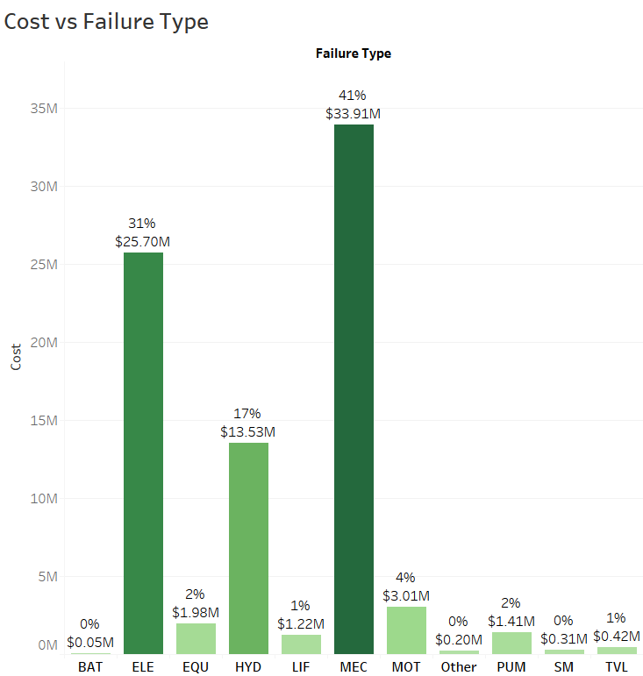
Analysis of each Type of Failure
Summary
The 3 main types of failures are Mechanic (MEC), Electric (ELE) and Hydraulic (HYD) which have the highest cost.
MEC accounts for 41% of the total cost which is $33.91m.

Slide 31
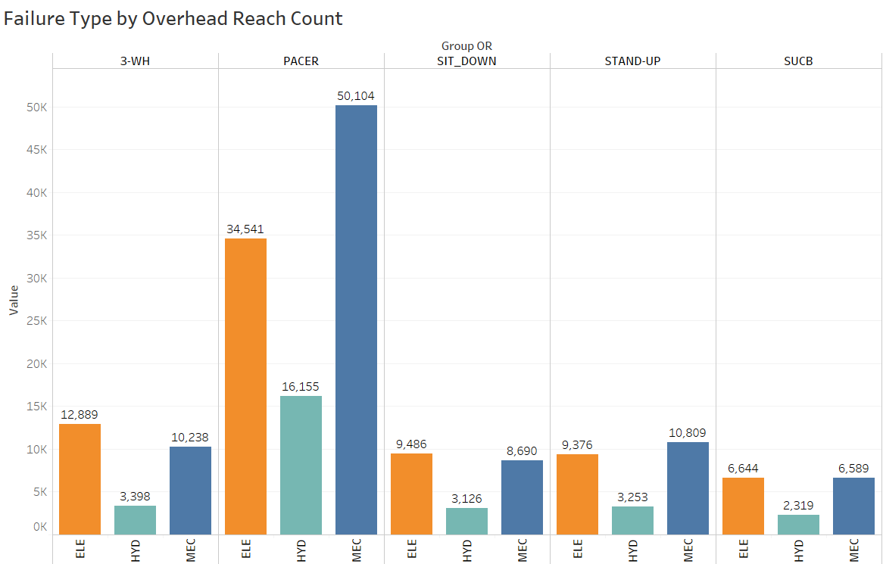
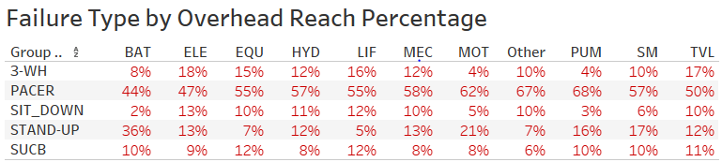
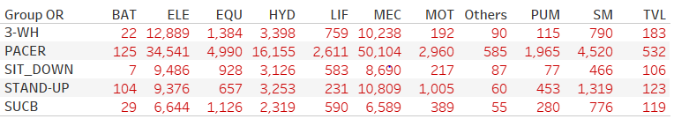
Analysis of each Type of Failure by Overhead Reach
Summary
The 3 main types of failures are Mechanic (MEC), Electric (ELE) and Hydraulic (HYD) which also have the highest cost.
For these 3 main types of failures, the plot shows their frequency within each Overhead Reach group.
Within each truck, Battery and Other type repairs occur the least.

Slide 32
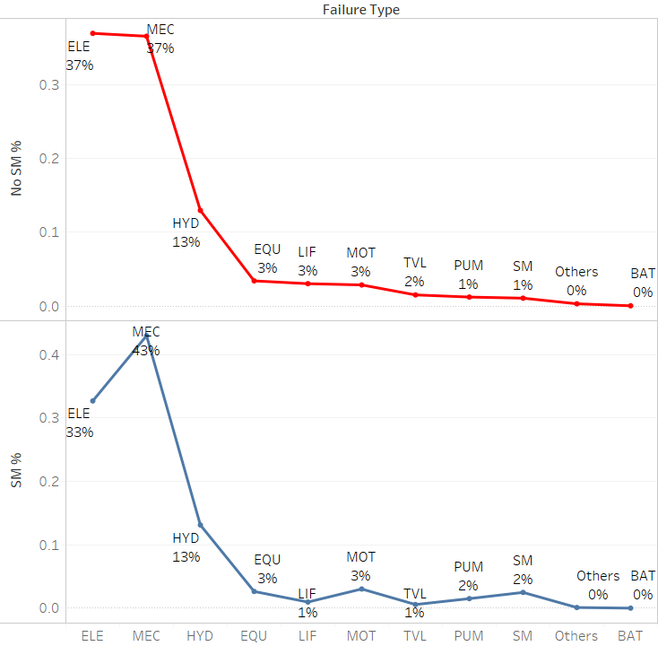
Frequency of Repair Types
Summary
The plots show frequency of each repair type when a truck does not use an SM plan and when a truck uses an SM plan.
Failure types ELE, LIF, and TVL occur less frequently when SM plan is used compared to when it is not used.
Most Frequent: For SM – MEC, For Non-SM - ELE

Slide 33
Part V Optimal Service Time Interval Prediction

Slide 34
Optimal Service Time Period Prediction (by minimizing cost per hour)
Summary
Based on the various demographics of the truck which are only known before-hand, a model to predict Optimal Service Time Period was built by first minimizing cost per hour for each truck.
The truck features used for this model to predict Cost per hour were:
SM Interval Group
Installation Year
Customer State
Overhead Reach
Mast Type
Note: These were the limitations faced to predict the cost per hour due to the business problem in question.
Basic idea used to minimize the cost per hour for a truck was scenario prediction using 7 Random Forest Regression models with 500 trees and using the “entropy” measure which reduces the standard deviation of predictions to help increase information gain.
Each model predicts the cost per hour for all trucks falling in each of the 7 SM Interval groups respectively.
Based on clubbing the predictions of each model, the result is in the form of a 7-column matrix with cost per hour predicted for all trucks for each of the 7 SM Interval groups respectively (these are 7 different scenarios for each truck).
From this matrix, with each truck having 7 different costs per hour in each column, a minimum cost per hour was chosen along with it’s corresponding SM Interval Group (column number).
This results in a final value which tries to minimize the cost per hour for each of the truck.
An example is shown below

Slide 35
Optimal Service Time Period Prediction
Cost per hour predicted from the model
If Interval 1 | If Interval 2 | If Interval 3 | If Interval 4 | If Interval 5 | If Interval 6 | If Interval 7 | Minimum predicted | Interval Chosen
7.07 | 2.246 | 3.63 | 3.027 | 2.81 | 2.7 | 2.879 | 2.246 | 2
2.408 | 2.24 | 1.769 | 1.93 | 2.247 | 2.568 | 3.46 | 1.769 | 3
1.875 | 1.962 | 1.975 | 1.771 | 2.206 | 2.283 | 1.57 | 1.57 | 7
4.633 | 1.851 | 4.068 | 2.09 | 2.168 | 2.153 | 1.67 | 1.67 | 7
6.633 | 3.776 | 2.961 | 1.875 | 2.069 | 1.951 | 2.597 | 1.875 | 4
3.946 | 1.546 | 3.656 | 1.961 | 2.642 | 2.456 | 2.054 | 1.546 | 2
Table 1: | 1 | 2 | 3 | 4 | 5 | 6 | 7
Total | 404 | 364 | 82 | 217 | 61 | 230 | 396
Percentage | 23% | 21% | 5% | 12% | 3% | 13% | 23%
Table 2: | 1 | 2 | 3 | 4 | 5 | 6 | 7
Total | 62 | 161 | 471 | 626 | 311 | 74 | 49
Percentage | 4% | 9% | 27% | 36% | 18% | 4% | 3%
Summary
Note: These are not actual results, just shown for explanatory purposes.
Like the example above, the model predicts the minimum results (shown in green) and chooses the appropriate SM Interval Group for that minimum result.
This model provides a 60% reduction in cost per hour in the test set by minimizing the cost per hour and assigning the appropriate SM Interval Group to the respective trucks using this model, which meets the main business objective of minimizing the cost per hour for each truck.
Table 1 shows count of services within each SM Interval based on the predicted model tested on the test dataset while Table 2 shows the actual count within each SM interval group based on the test dataset.
Based on table 1, which is our only validation measure, the model does reasonable prediction of SM Interval Groups based on the reduced costs as more than 50% of the data is assigned to Interval groups 2-6, which are the most regular services groups.

Slide 36
Part VI Conclusion

Slide 37
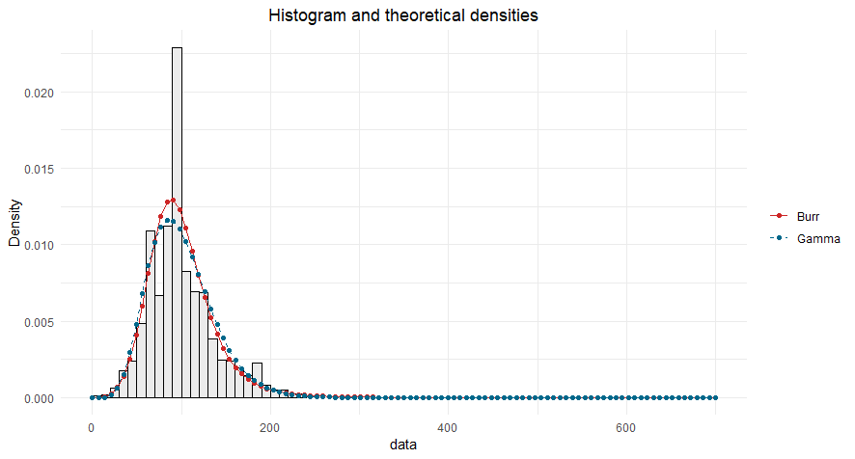
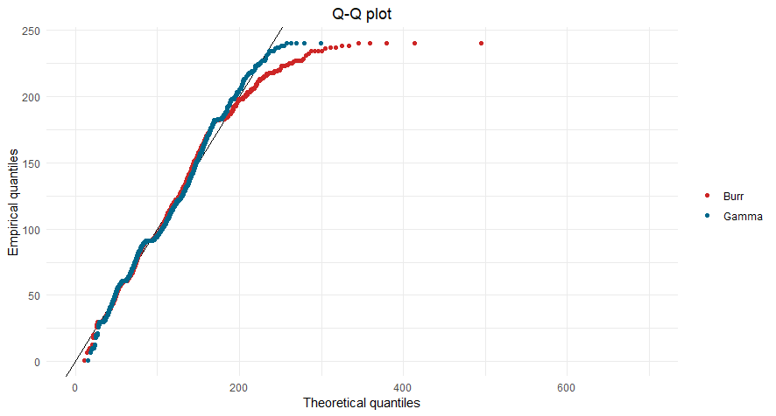
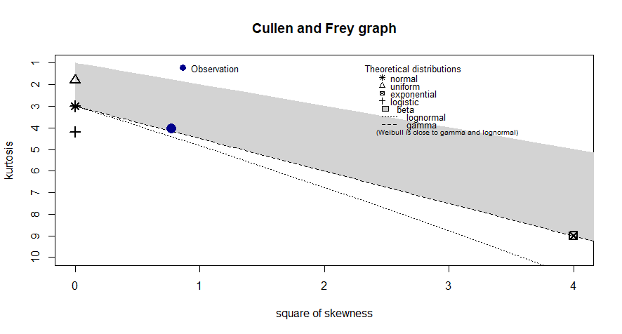
Fitting Distribution to the Average Interval Data (refined)
Summary
After removing the 2 unwanted interval groups, Gamma distribution is the best distribution for the remaining data.
The above plots compare Gamma and Burr distribution, while the Cullen and Frey graph indicates the blue observation dot lies on the Gamma distribution line.

Slide 38
Optimal Service Time Period Prediction (refined)
Table 1: | 1 | 2 | 3 | 4 | 5 | 6 | 7
Total | 0 | 775 | 216 | 229 | 135 | 288 | 0
Percentage | 0% | 47% | 13% | 14% | 8% | 18% | 0%
Table 2: | 1 | 2 | 3 | 4 | 5 | 6 | 7
Total | 0 | 161 | 471 | 626 | 311 | 74 | 0
Percentage | 0% | 10% | 29% | 38% | 19% | 5% | 0%
Summary
After removing the SM Intervals 1 and 7, the model is trained on the remaining groups and it’s results are presented here.
This method reduces the cost by 54%, and the assignment of minimum cost per hour to SM Interval groups is more effective, generating more realistic results.

Slide 40
Special Thanks: Our advisor: Dr. John Bunge
The Raymond Corporation Team

Slide 41
Thank You for your time.

